Slide 1
ScholarGraph
Agentic AI Literature Review & Research Gap Discovery
PROJECT TEAM
PROJECT GUIDE PROJECT CO-GUIDE
Mohammad Abuzaid 4NI23CS110
Mr. Joyan Prajwal Alvares Mrs. Amruthashree V. M
Mayank Vyas 4NI23CS106
Assistant Professor, Dept. of CS&E Assistant Professor, Dept. of CS&E
NIE, Mysuru NIE, Mysuru
Mohammed Farhan Tadpatri 4NI23CS112
Harshit Kumar 4NI23CI039

Slide 2

INTRODUCTION
What is ScholarGraph?
An agentic AI platform that simplifies and automates the academic literature review process from start to finish.
Retrieves papers automatically from multiple scholarly databases.
Automated Assistance
Extracts key data (methods, metrics, datasets) using LLMs.
Reduces weeks of manual searching and compiling into an autonomous workflow.
Identifies research gaps by mapping citation connections.

Slide 3
LITERATURE SURVEY
Foundational Research Papers
Silva-Fuentes et al. (2019)
Silva & Wickramarachchi (2025)
Semantic Search System using Word Embeddings.
Evaluating LLM-Based Tools Across SLR Stages.
Kalla et al. (2023)
Zheng et al. (2025)
Scientific Knowledge Graph Creation and Analysis.
Information-Constrained Literature Retrieval via Agents.
Pozzobon & Pinheiro (2024)
Al Azher et al. (2025)
RAAI: Literature Review Assistant with LLMs.
FutureGen: RAG-based Future Work Generation.
Procko & Ochoa (2024)
Gao et al. (2023)
Graph RAG for Large Language Models.
Retrieval-Augmented Generation: A Survey.
Ibn Ahad et al. (2024)
Lála et al. (2023)
Leveraging LLMs for Scientific Meta-Analysis.
PaperQA: Retrieval-Augmented Generative Agent.

Slide 4
LITERATURE SURVEY
Key Contributions & Relevance
Silva-Fuentes et al.
Validates word embeddings for semantic search over exact-keyword matching. Foundation for ScholarGraph's ChromaDB vector retrieval.
Kalla et al.
Constructs academic knowledge graphs utilizing centrality metrics for node importance. Basis for our NetworkX citation topology.
Pozzobon & Pinheiro
Demonstrates multi-database ingestion (IEEE, arXiv) via LLMs. ScholarGraph extends this with full PDF parsing and graph visualization.
Ibn Ahad et al.
Investigates LLMs for cross-paper scientific synthesis and tabular comparative extraction. Directly implemented in our Synthesis Agent.
Zheng et al.
Uses LLM agents for dynamic ranking and query decomposition to improve relevance. Inspires the ScholarGraph Planner Agent workflow.
Lála et al. (PaperQA)
Shows citation-grounded LLM generation eliminates scientific hallucination. Adopted for bracketed sentence-level citations.

Slide 5
RESEARCH GAP
The Need for Integration
While tools exist for isolated tasks, there is no unified system that combines multi-source retrieval, semantic search, LLM synthesis, and graph-based gap discovery into a single workflow.
Fragmented Toolchains
Subjective Gap Analysis
Manual Deduplication

Slide 6
EXISTING VS. PROPOSED SYSTEM
Workflow Transformation
Existing Solutions
Proposed: ScholarGraph
Tools like SciSpace, Elicit, Consensus, and Litmaps.
End-to-end agentic workflow.
Single-Source Limits: Rely heavily on isolated databases (e.g., Semantic Scholar only).
Unified Corpus: Concurrent ingestion from arXiv, IEEE Xplore, and Semantic Scholar.
Abstract-Only Focus: High hallucination risk without full-PDF parsing.
Targeted Extraction: PyMuPDF + LLM isolates methods/datasets with quote grounding.
Subjective Analysis: Gaps rely on human intuition or speculative LLM text.
Empirical Gaps: Identifies under-explored areas using NetworkX citation density.

Slide 7
REQUIREMENTS
Hardware & Software Stack
Hardware
Software
Processor | Dual-core CPU (Intel i5 / Ryzen 5+)
Memory | 4 GB RAM (8 GB+ recommended)
Storage | 2 GB disk for ChromaDB vector cache
Core Logic | Python 3.10+, LangGraph
Data & Graph | ChromaDB, NetworkX, PyMuPDF
Web Interface | FastAPI (Backend), React + Vite (UI)

Slide 8




SYSTEM DESIGN
6-Agent LangGraph Architecture
Planner
Search
Extraction
Synthesis
Graph/Gap
Report
Query Decomposition
Multi-Source Retrieval
Targeted PDF Parsing
Comparison Matrices
Citation Topology
PDF & DOCX Export

Slide 9
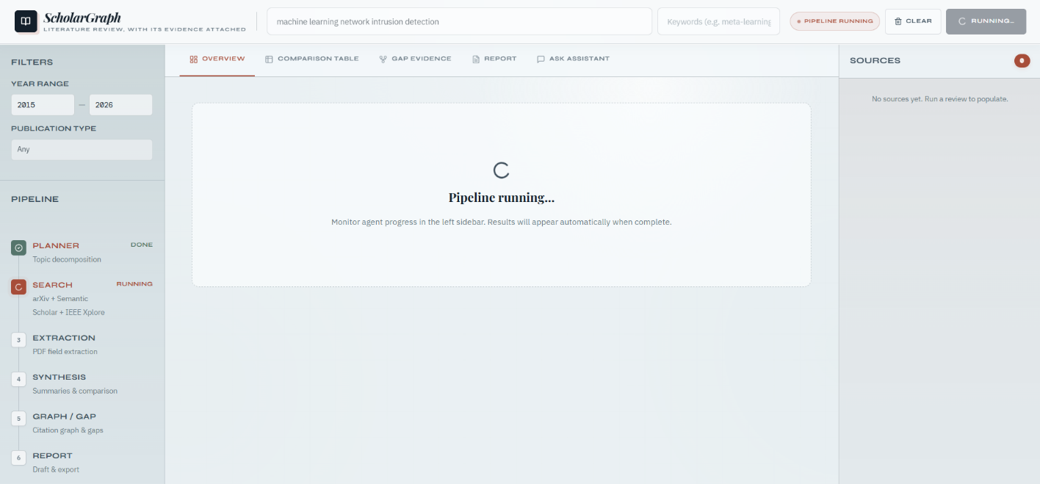
IMPLEMENTATION
Pipeline Execution
State Management: Centralized PipelineState coordination.
Live Streaming: FastAPI SSE tracks state transitions.
Background Tasks: Non-blocking ChromaDB indexing.

Slide 10
TESTING METHODOLOGY
Validation Suites
Unit Testing
Edge Cases
Integration
•
Agent independence.
•
API rate limit fallbacks.
•
End-to-end state transitions.
•
Sub-query decomposition.
•
Abstract-only processing.
•
Mocked LLM CI paths.
•
Citation density logic.
•
Missing DOIs & identifiers.
•
ChromaDB persistence.

Slide 11

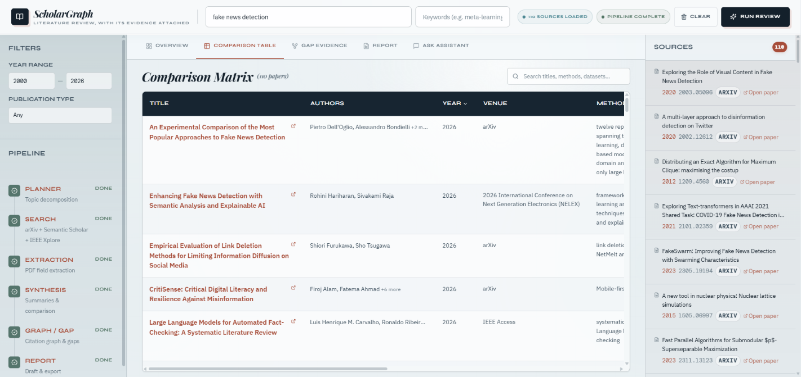
RESULTS
Automated Matrix Synthesis
110
47%
Papers Processed
Full PDF Parsing

Slide 12
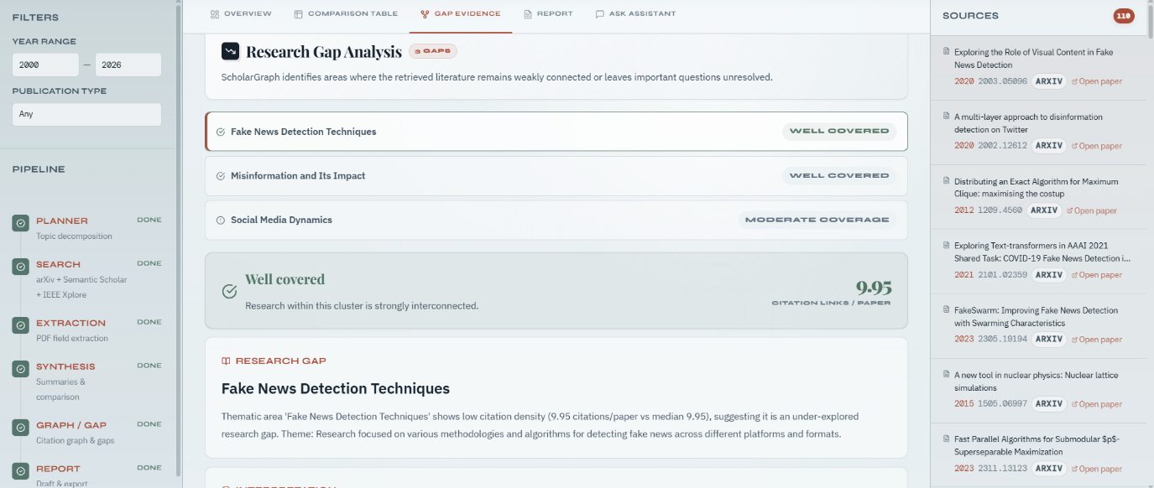
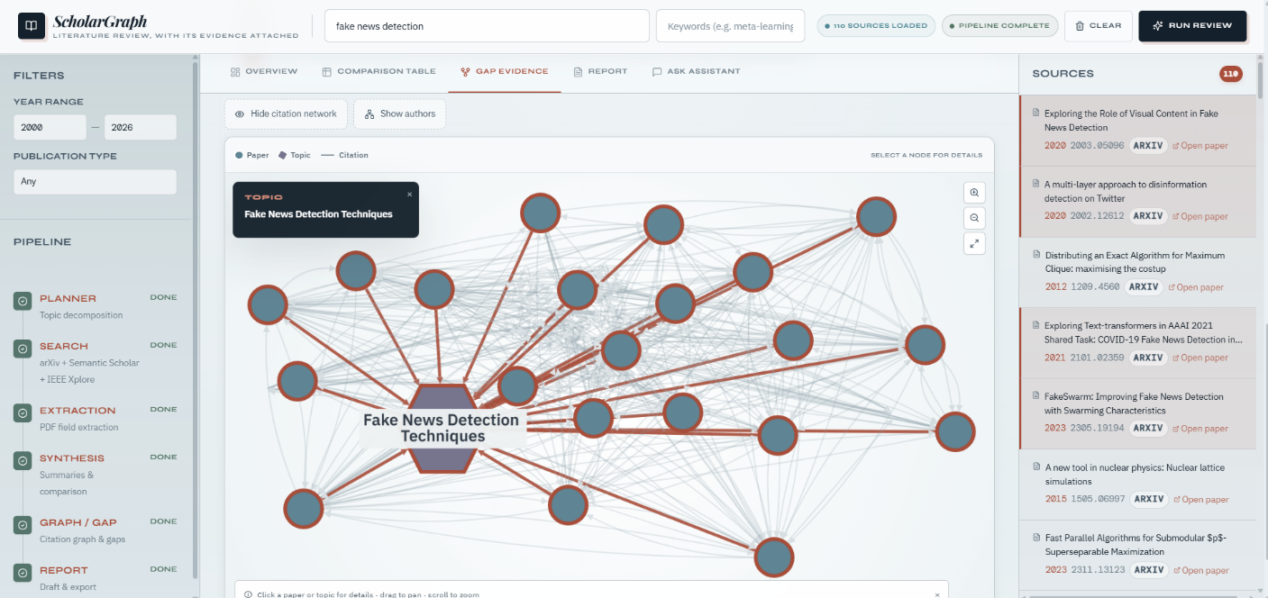
FINAL PROJECT DEMONSTRATION
Interactive Gap Evidence
Identifies research gaps via statistical density analysis (e.g., density ≤ median).
Topological Verification
Every gap claim connects directly to an inspectable NetworkX/Cytoscape subgraph.

Slide 13
Thank You
ScholarGraph establishes a verifiable, agentic paradigm for topologically grounded academic research.
QUESTIONS & DISCUSSION

